Slide 1
MEETHUB Your Community, Your Space, Your Way
Team members
Sambhaji Shinde (BT3259)
Saurabh Sahalugde (BT3260)
Varad Puranik (BT3262)
Guide :- Ms. D. D. Dharmadhikari

Slide 2
Content
Problem Statement
Objective
Progress
Algorithm
Framework Technology And Tools Being Used
Identification Of Individual Responsibility
Conclusion
References

Slide 3
MeetHub
Problem statement :-
Traditional online learning platforms lack the real-time collaboration and interactive features required for an engaging distributed learning experience.
Abstract :-
It’s collaboration tool, providing features for video conferencing, online meetings, content sharing, interactive learning activities and within the virtual classrooms.

Slide 4
Objectives
Enable real-time video communication.
Provide a collaborative, real-time whiteboard.
Support simultaneous multi-user document editing with online saving.
Ensure secure, synchronized access for all shared content.
Integrate multiple collaboration tools in one app.

Slide 5
PROGRESS
1
2
3
4
100%
100%
100%
100%
Team Formation & Project Selection
Design
& Implementation
Integrating Advanced Features
Final Product
&
Presentation

Slide 6
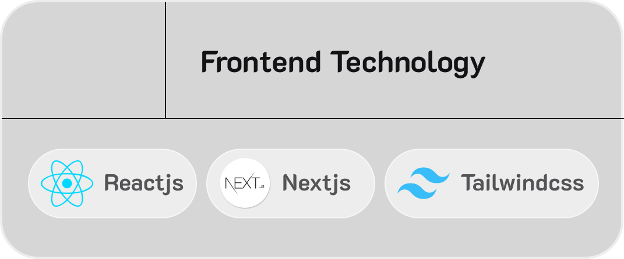
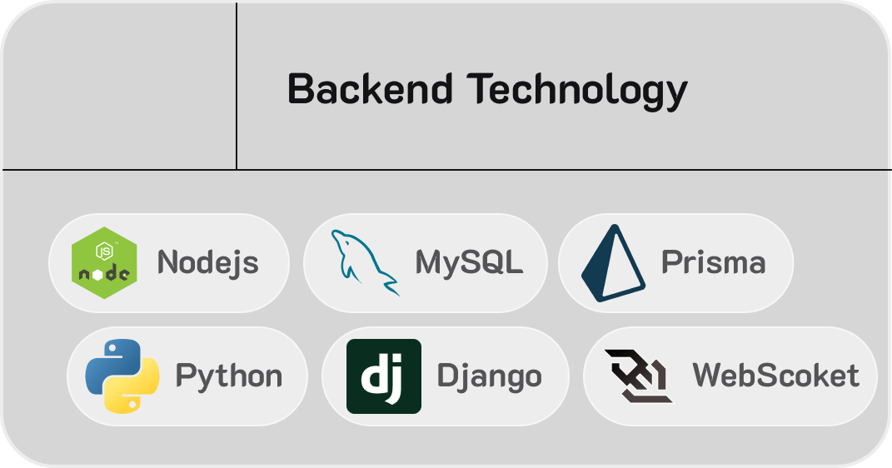
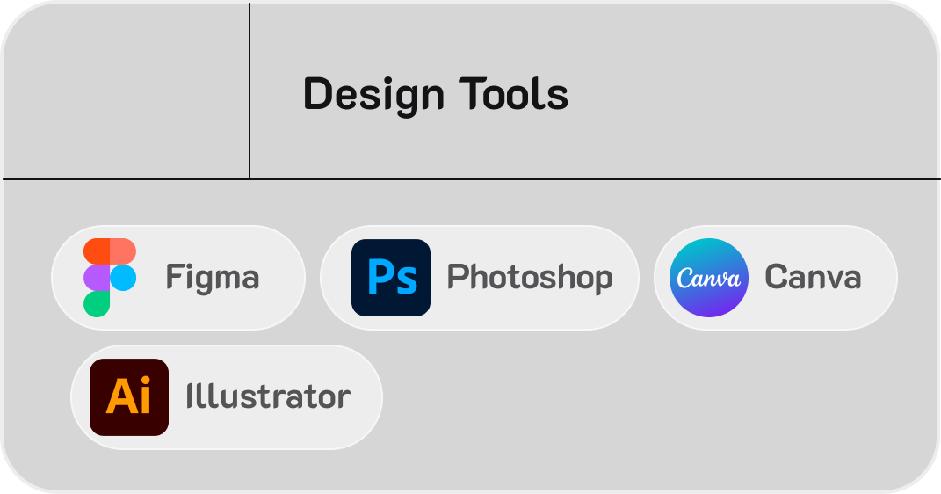
Framework, Technology And Tools Being Used

Slide 7
Identification Of Individual Responsibility
Sambhaji Shinde ( Backend Developer) | Saurabh Sahalugde ( System Design, Documentation maintaining )
Varad Puranik (UI/UX Designer, Frontend Developer )

Slide 8
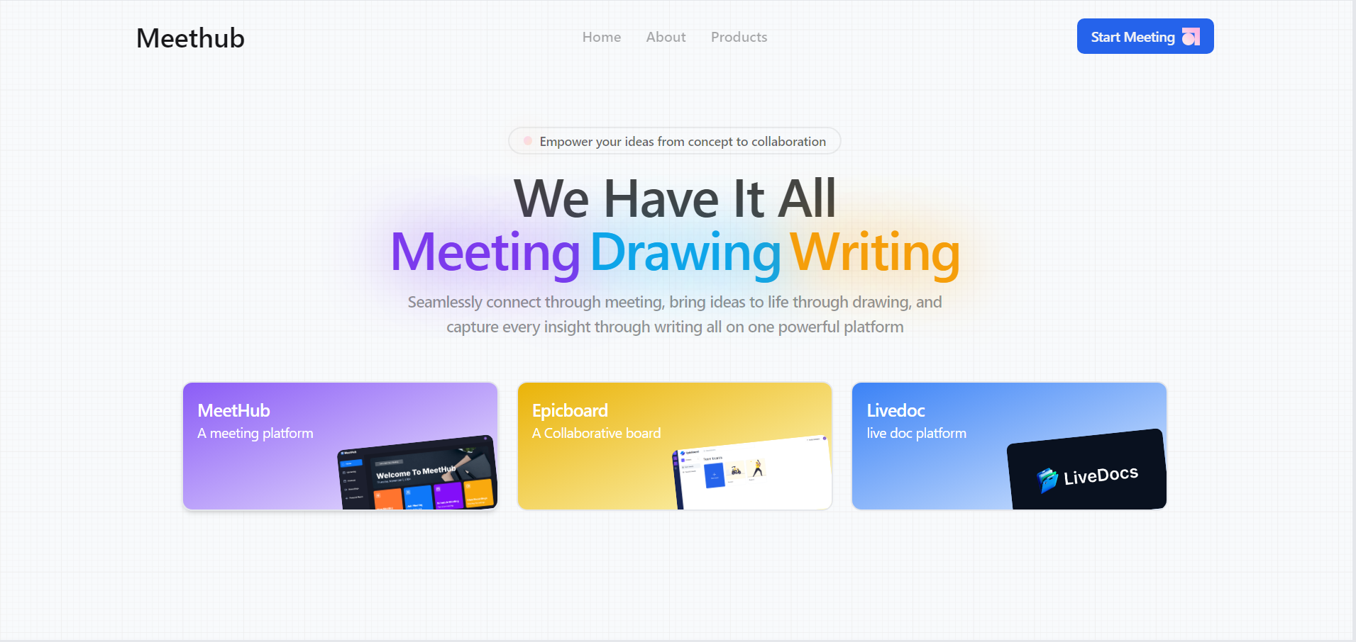
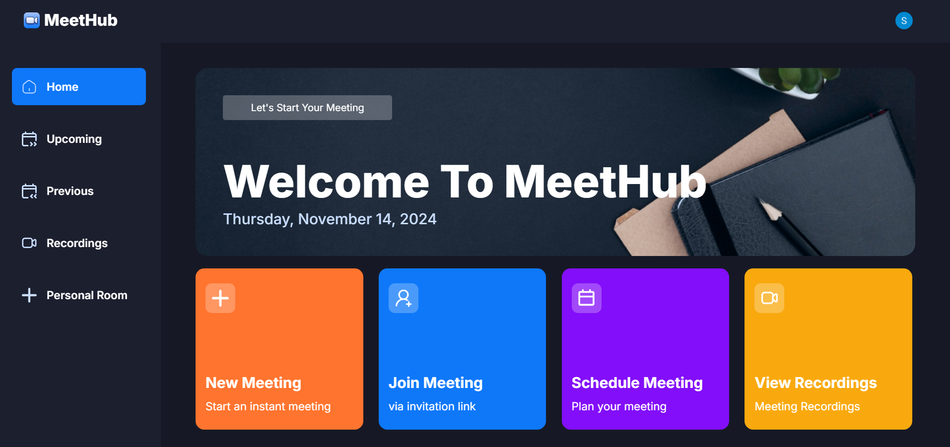
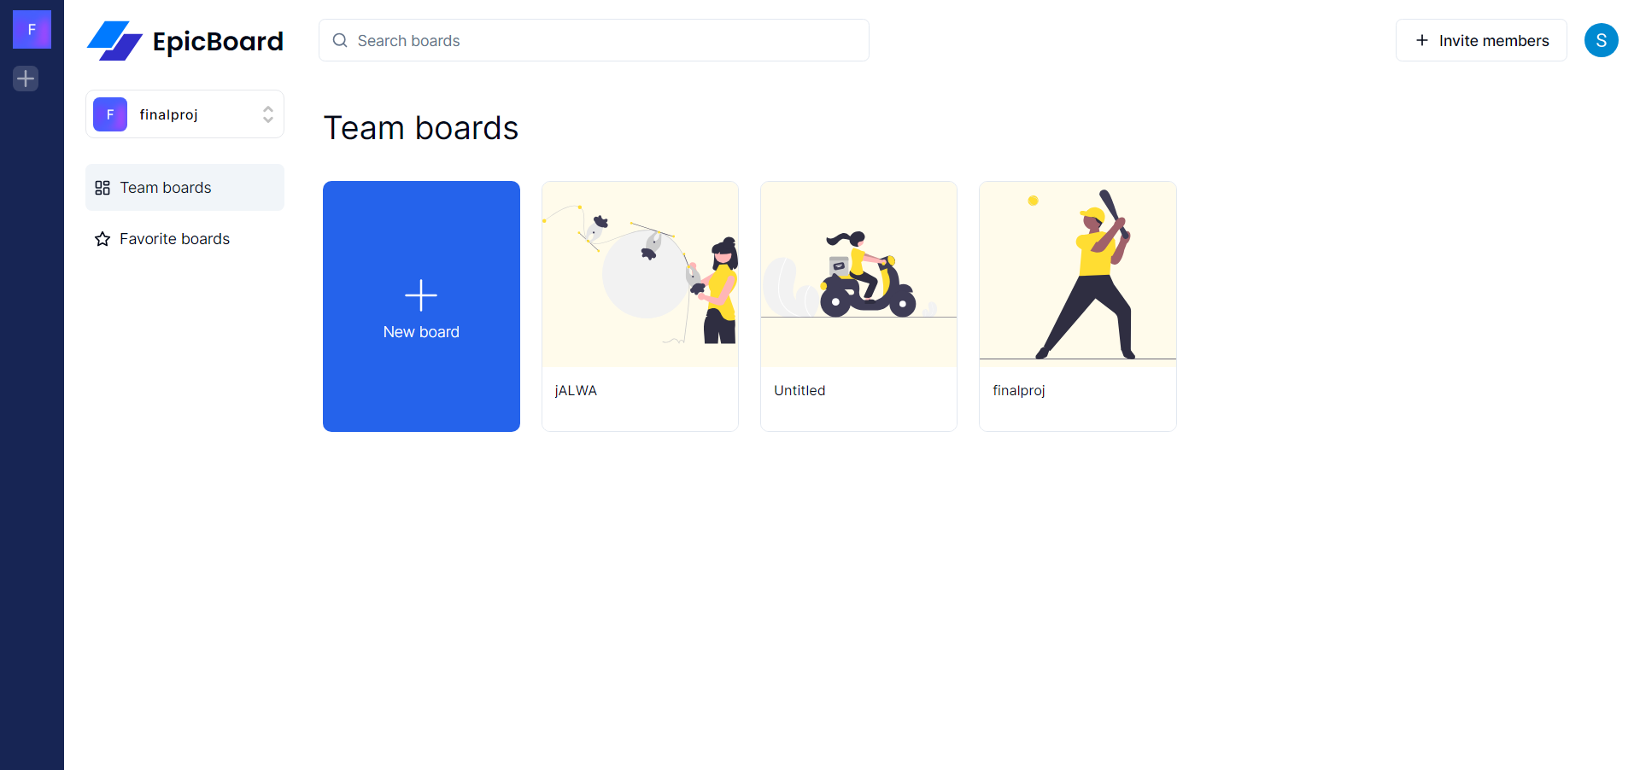

Final Website Images

Slide 9
Conclusion
In conclusion, we have understood that MeetHub provides users with a versatile platform for communication and collaboration within communities
The User flow outlines the basic steps users typically follow when interacting with MeetHub
Despite its simplicity, the flowchart reflects the user-friendly nature of MeetHub, making it easy for individuals to navigate and engage with various communities.

Slide 10
THANK YOU

